Slide 1
AI Enabled Autonomous Nervous System Intelligent Monitoring (ANSIM)
SC-IVS

Slide 2
Content
Experiments Workflow
Data Pre-processing
Systolic Value Prediction: A Machine Learning Experiment
Windowing data
Training and Evaluating the model
Next Experiment

Slide 3
Content
Experiments Workflow
Data Pre-processing
Systolic Value Prediction: A Machine Learning Experiment
Windowing data
Training and Evaluating the model
Next Experiment

Slide 4
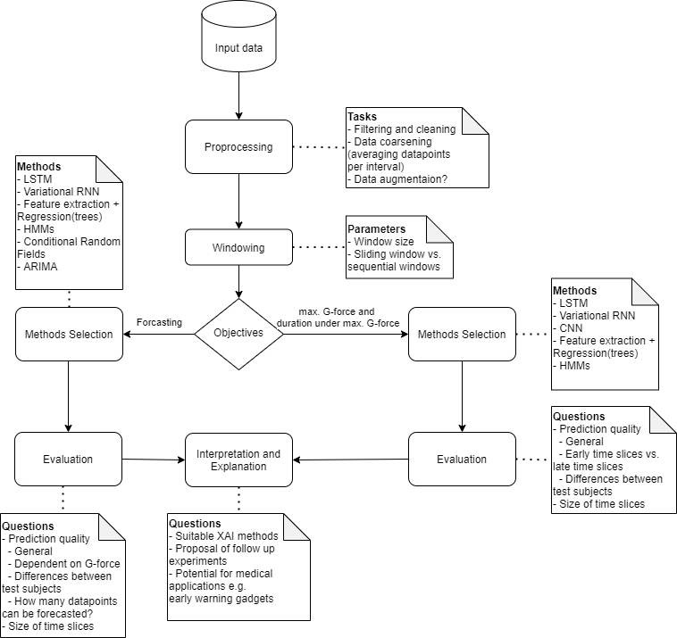
Experiments Workflow

Slide 5
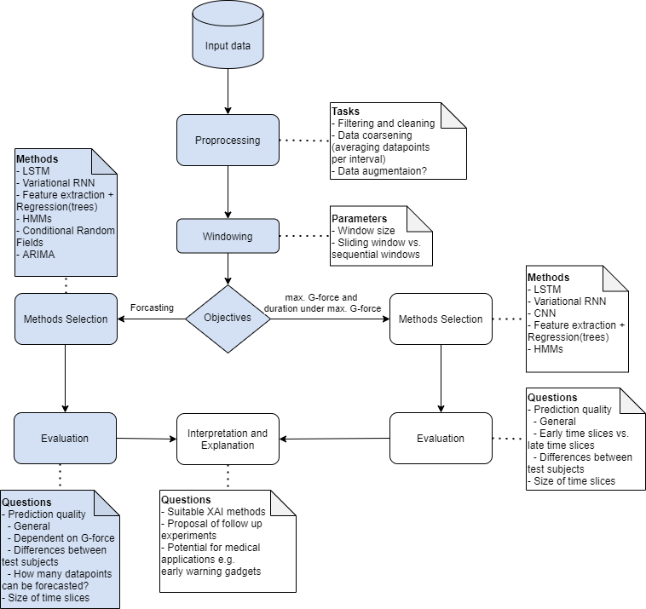
Experiments Workflow Part I

Slide 6
Content
Experiments Workflow
Data Pre-processing
Systolic Value Prediction: A Machine Learning Experiment
Windowing data
Training and Evaluating the model
Next Experiment

Slide 7
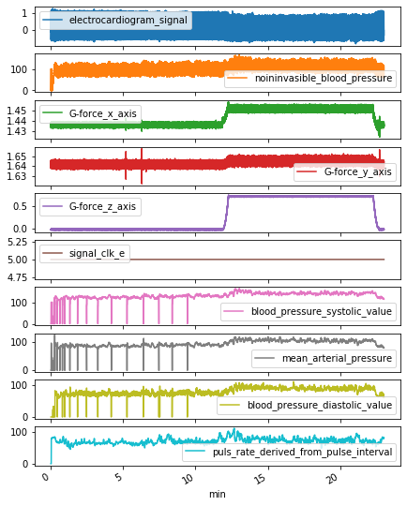
Data Pre-processing Overview
One Run Example
We have:
18 subjects
73 runs
Each subject has 4 runs except 0AA (5 runs)
BIO1E was used in all runs except for subject 0AA (2 with BIO1E and 3 with FIN1E)
We dismiss runs for subject 0AA (5 runs)
Out of 68 runs, only 34 has a max G-force z-axis > 0.75
→ We dismiss runs with G-force z-axis < 0.75

Slide 8
Content
Experiments Workflow
Data Pre-processing
Systolic Value Prediction: A Machine Learning Experiment
Windowing data
Training and Evaluating the model
Next Experiment

Slide 9
Machine Learning Experiment
Supervised Machine Learning.
It is a task of learning a function that maps an input to an output, based on example of input-output pairs.
It learns this function using a training data and it is evaluation using an unseen data (test data).

Slide 10
Machine Learning Experiment Task
Input
Task. Given at least m current minutes with
Elctrodiagram signal
Non-invasible blood pressure
G-force z-axis
Blood pressure systollic values
predict the blood pressure systollic in the
next n minute.
Output

Slide 11
Machine Learning Experiment Windowed Data
run1_x1
run1_x2
We repeat this process on each run (34 runs)
input
output
run1_x1
run1_y1
run1_x2
Run1_y2
…
…
Run1_y1
Run1_y2
run34_x1
run34_y1
…
…

Slide 12
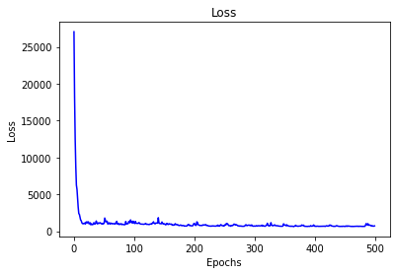
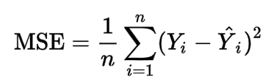
Experiment
Setting. Train test split (80/20)
Algorithm. Long short-term memory
Is a deep learning architecture.
Good for preprocessing sequences (e.g. Timeseries data)
LSTMs have a cell state that keeps a state throughout the life of the training so that the state is passed from cell to cell, timestamp to timestamp.
Evaluation. Means Squared Error
actual - predicted

Slide 13
Content
Experiments Workflow
Data Pre-processing
Systolic Value Prediction: A Machine Learning Experiment
Windowing data
Training and Evaluating the model
Next Experiment

Slide 14
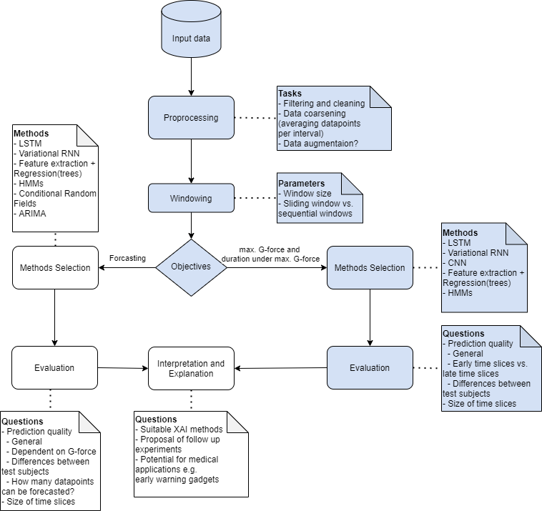
Experiments Workflow Part II

Slide 15
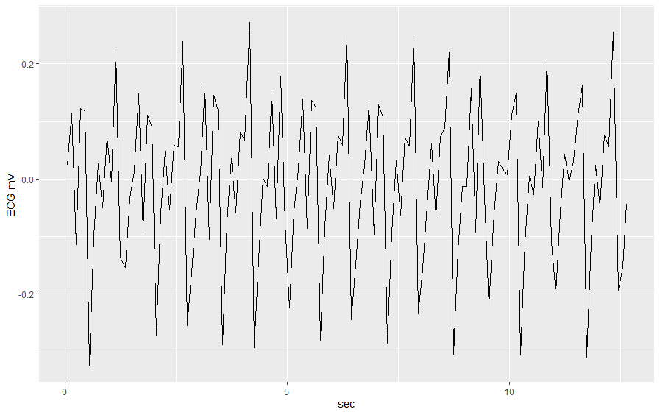

Next Experiment Prediction of Maximum G-Force and Tolerance
3. Prediction of tolerance to increased G-force
1. Windowing:
Dividing the time series into overlapping sections
for all flows and persons..
2. Train ML Models
Achieved window G-Level Duration
Trained predictor
Exp. 1
2.5, 2 min.
0.75, 3 min.
… … 3, 1 min.
.
Exp. 2
Training and Test
Data
…
Max. G-Level
Tolerance
Exp. n
Prediction Model

